Slide 1
MECHANICAL Core Memory
The Memory Maker Challenge

Slide 2
The problem
Design a mechanical method of storing data
Traditional electronics won't work
Works in hostile environment e.g. Venus

Slide 3
Solution parameters
Can use simple electronic components- wires, resistors, inductors
Although electronic components can fail in the atmosphere, electricity works fine
Electrical signals of 18v @ 600ma. I.e. 2 9v batteries can be used for input/output
Memory: An ideal system can store 1MB of digital data(8,000,000 bits).
Size: An ideal system fits into a box that is 250mm by 1000mm by 1000mm.
Mass: An ideal memory system is less than 25 kg, including packaging.

Slide 4
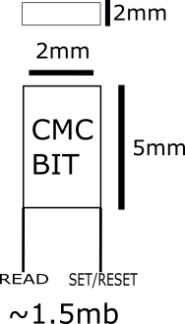
Solution- CMC bit

Slide 5
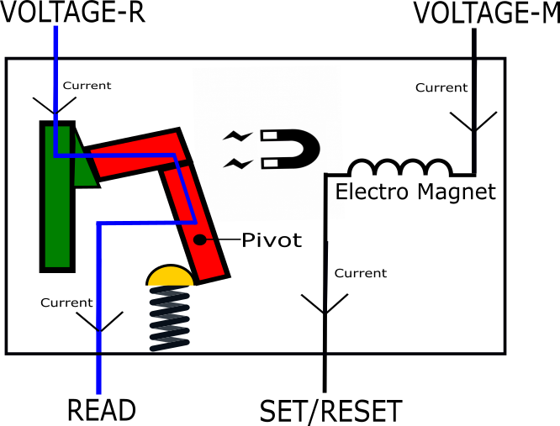
A look inside binary 1
304 stainless steel

Slide 6
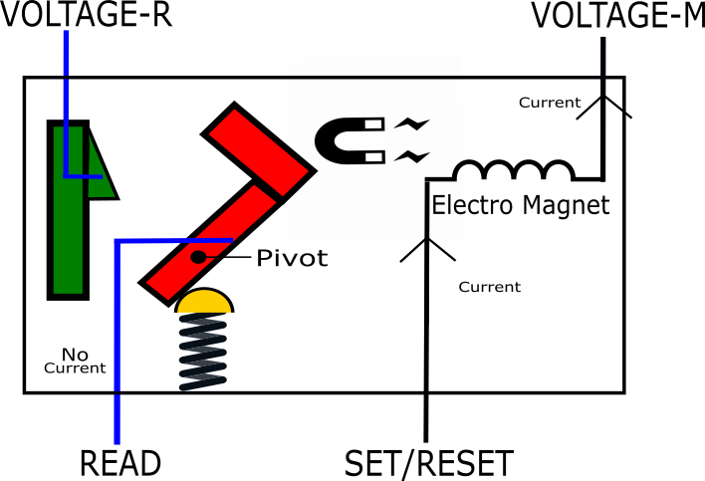
A look inside binary 0

Slide 7
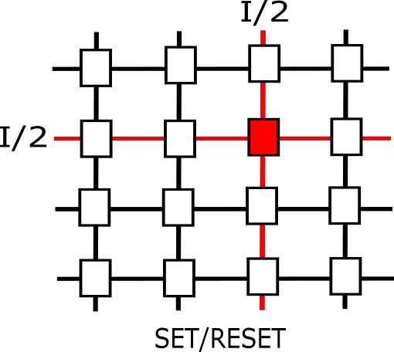
Set/reset the bit

Slide 8
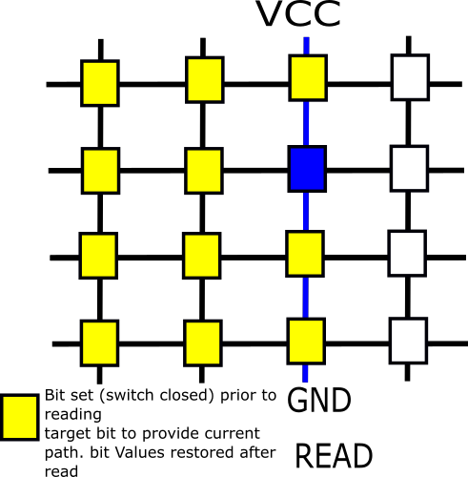
Read A Bit

Slide 9

Problem solved ?
Can use simple electronic components- wires, resistors, inductors
Uses only wires and inductors for electrical components
Electrical signals of 18v @ 600ma. I.e. 2 9v batteries can be used for input/output
Low voltage electrical signals are used (5v) for input and output
Memory: An ideal system can store 1MB of digital data(8,000,000 bits).
Theoretical capacity of 1.5mb
Size: An ideal system fits into a box that is 250mm by 1000mm by 1000mm
Each binary bit has a size of 5x2x2mm allowing up to 12,500,000 bits to be store

Slide 10
Thank you!

